Slide 1
Intro to Online Marketing

Slide 2
Basic Marketing Concepts
What is marketing?
“Everything you do to promote your business from
the moment you think of the product idea until
customers buy your products on a regular basis.”
- Jay Levinson, author of Guerrilla Marketing

Slide 3
Basic Marketing Concepts
What is marketing?
The process of finding out what customers want and/or need and satisfying those needs in a profitable way.

Slide 4
Basic Marketing Concepts
Sell products that customers want!
Learn as much as you can about your market
Set aside time/money to research your market
Develop a list of key questions to ask
Decide what type of information you need
Document your results

Slide 5
Basic Marketing Concepts
Identify the customers you are trying to attract
Develop a customer profile:
Demographics
Lifestyle patterns
Expectations
Focus your marketing efforts on this target market
Sell products that customers want!!!

Slide 6
Basic Marketing Concepts
Share background information about yourself and your business
Emphasize the key (unique) features of your products and services
Test market new products
Provide samples and develop flyers, brochures & displays

Slide 7
Basic Marketing Concepts
Solicit feedback from your customers
Seek training for yourself and your employees
Develop a written customer service policy

Slide 8
Basic Marketing Concepts
Develop a consistent brand.
Your brand is what your customers know and believe
about your business and is your way of differentiating
yourself within the marketplace
Brand = reputation + sum of all customer experiences

Slide 9
Basic Marketing Concepts
Key steps in creating a brand:
Find out what is unique about your business that customers want
Determine what the key benefits are of doing business with you
Identify what promises you have made to your customers
Create a high-quality, simple logo and color scheme (professional)
Use it on everything!

Slide 10
Logo, Signs, Packaging
Must be made well
To a customer
A quality brand = a quality business
Can be pricey but is a good investment
A poorly done logo creates a bad first impression

Slide 11
Basic Marketing Concepts
Develop a web presence
Create a well-designed website and promote it widely
Use web-based tools to communicate with customers:
Facebook
Twitter
LinkedIn
YouTube
Blogs
Emails
QR codes

Slide 12
Your Farm’s Website
A great way to reach people
Sign of legitimacy
Can be expensive to start-up
Needs to be
updated often

Slide 13
Basic Marketing Concepts
Develop a web presence
Carefully manage your web-based tools:
Start small
Unify your profile and branding
Link everything
Use Social Media

Slide 14
What is Social Media?
Social media is a term used to collectively describe a set of tools that foster:
interaction
discussion and community
allowing people to build relationships
sharing of information
Source: Tufts University http://webcomm.tufts.edu/web-resources-tufts/social-media-overview/

Slide 15
Key Principles:
Social media is about conversations, community, connecting with personalities and building relationships.
It is not just a broadcast channel or a sales and marketing tool.
Source: Tufts University http://webcomm.tufts.edu/web-resources-tufts/social-media-overview/

Slide 16
Key Principles:
Listen first, speak second.
Authenticity, honesty and open dialogue are key.
Allows you to hear what people say about you, but enables you to respond.
Source: Tufts University http://webcomm.tufts.edu/web-resources-tufts/social-media-overview/

Slide 17
Key Principles:
Be compelling, useful, relevant, engaging.
Don’t be afraid to try new things, but think through your efforts before kicking them off.
Source: Tufts University http://webcomm.tufts.edu/web-resources-tufts/social-media-overview/

Slide 18
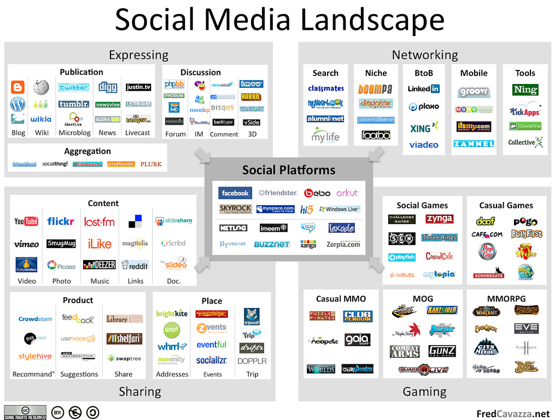

Slide 19
Social Media I Course Description
This course explores aspects of social media ranging from marketing to security and privacy concerns. Students will learn how to use the underlying structures of social networks to promote themselves and/or their businesses. Current trends in innovative online and community based technology are explored.
Course Goals
Upon completing the course, students will have:
been introduced to basic models of how ideas propagate through networks
learned specific techniques for applying those models to maximize the impact of their message
explored the unique characteristics of top social networking sites and developed methods of customizing messages to medium
gained an awareness of how to avoid the potential security and image pitfalls of marketing through social media
Instructor: John Bell Part of Innovative Communication Design Certificate Program
Email: john.bell@umit.maine.edu Source: http://umaine.edu/icd/
Skype: nmdjohn

Slide 20
How should you use social media?
It depends…
What message(s) do you want to convey?
How much time can you devote to it?
Are you comfortable with having multiple informal interactions with customers?

Slide 21
How should you use social media?
Some ideas…
Update customers about products, sales, etc.
Let the customer know more about you and your company.
To gauge interest in a potential new product or service before committing to it.

Slide 22
How should you use social media?
Some ideas…
Receive feedback on an ongoing basis.
24/7 Market Research!

Slide 23
One option: Facebook
1.35 billion users worldwide
1.12 billion mobile users (smart phone)
864 million daily active users in the U.S. & CA
One in five internet page views in the U.S. occurs on Facebook.

Slide 24
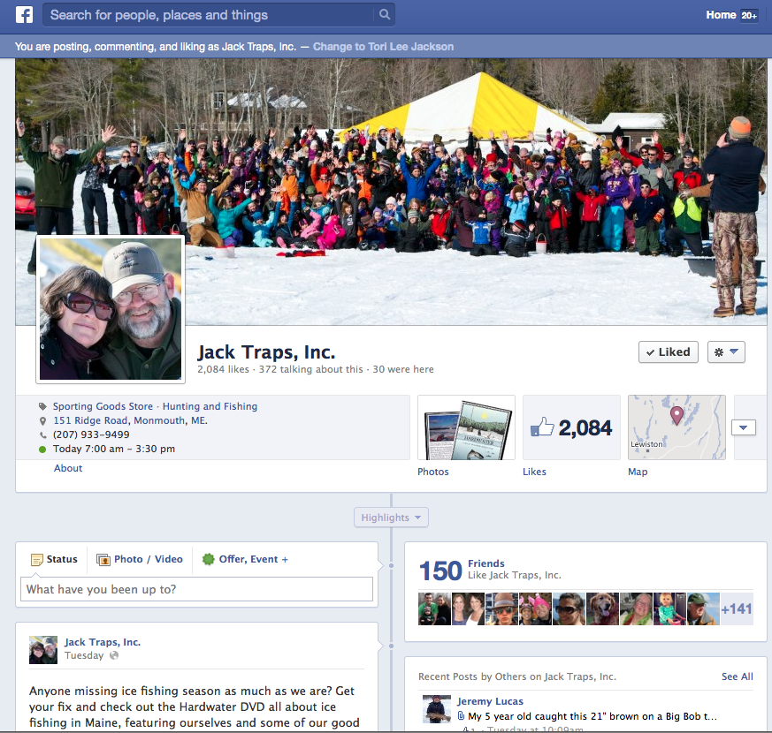
Example:
Jack Traps, Inc..
on Facebook
Not a farm, but…
Seasonal
Natural-resource based
Small

Slide 25
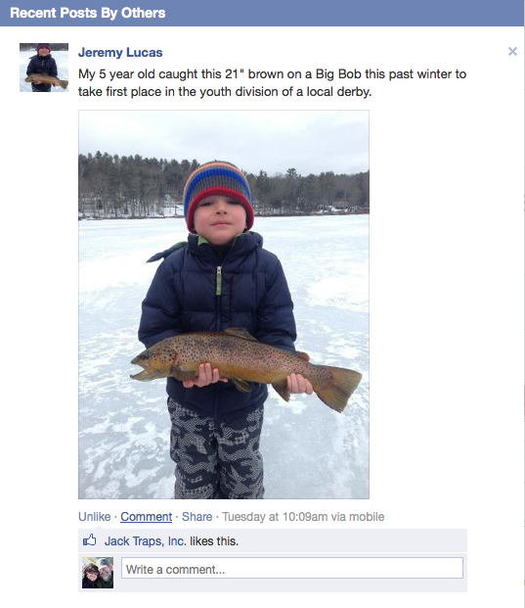
Example:
Jack Traps, Inc.
on Facebook

Slide 26
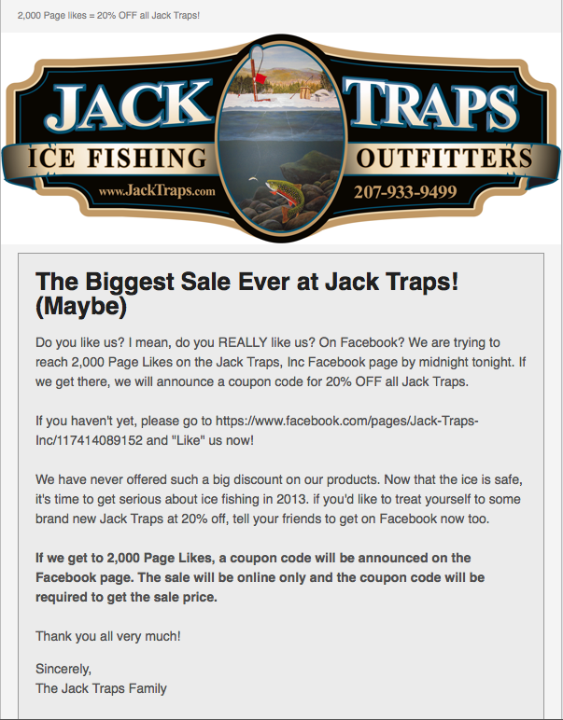
Example:
Jack Traps, Inc.
on Facebook

Slide 27
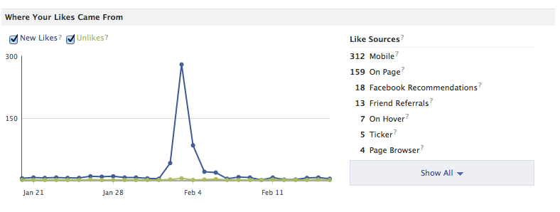
Example: Jack Traps, Inc. on Facebook
February 3, 2013: ~1,400 Page Likes
Challenged customers to get us to 2,000 in 3 days
Offered a 20% discount if we met our goal

Slide 28
Example: Jack Traps, Inc. on Facebook
Campaign and
Subsequent Sale
= $10k in one week!

Slide 29
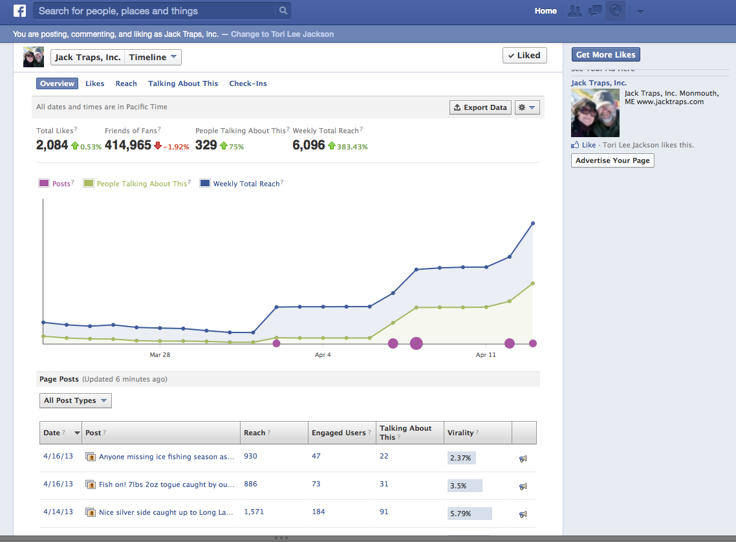

Slide 30
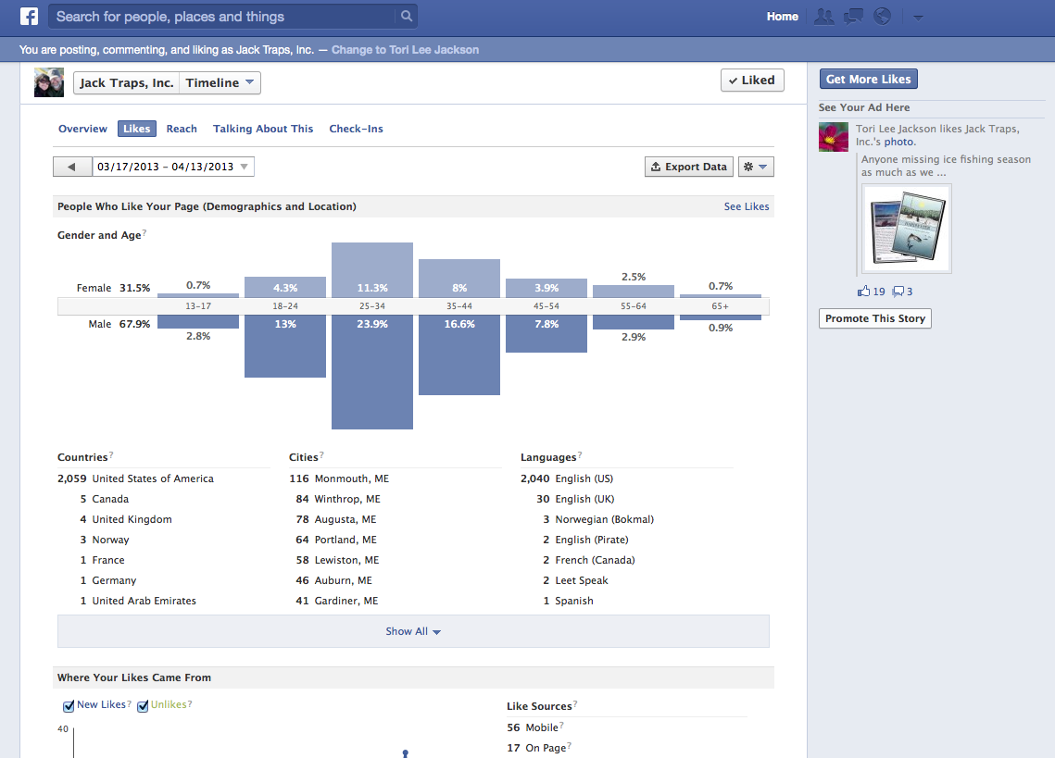

Slide 33
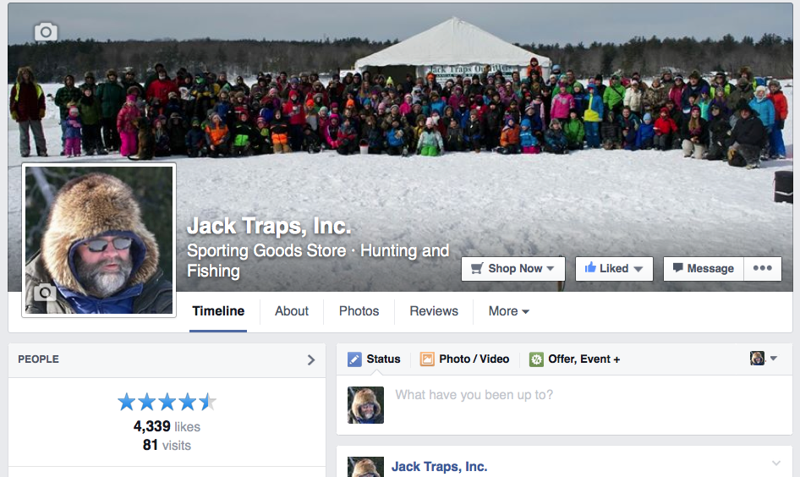

Slide 34
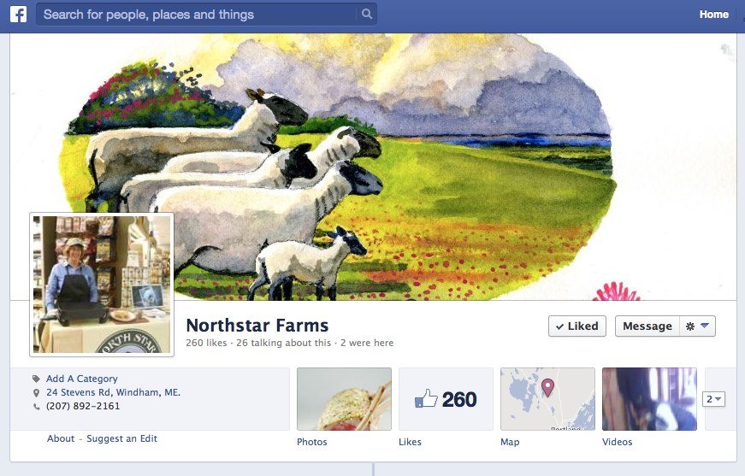
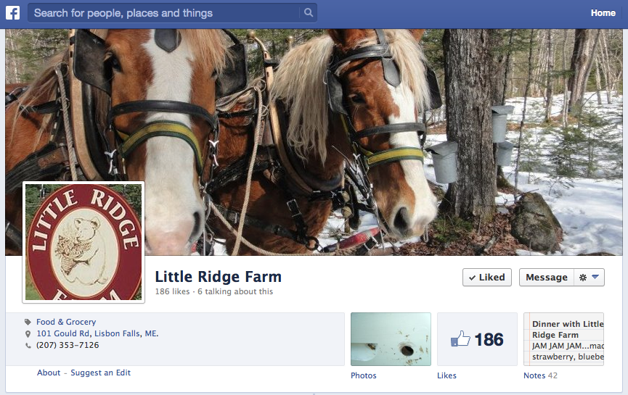
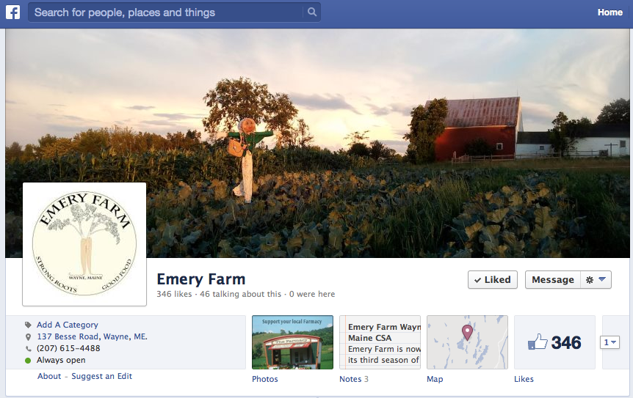
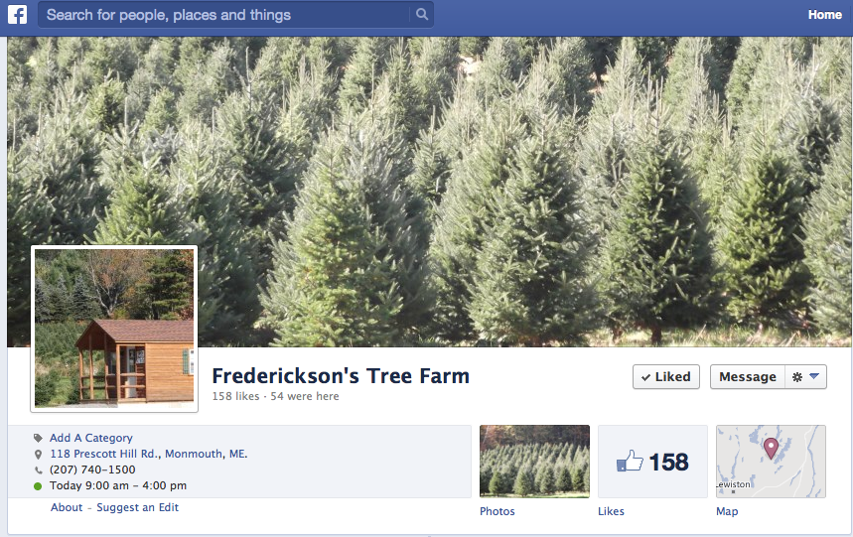
Maine farms are already doing this!

Slide 35
How can you use Facebook?
Keep customers engaged with your farm.
Offer special promotions to existing customers.
Remind customers when products are ready (ie. September means back to school AND peak harvest!)

Slide 36
What Should I Say?
Focus on why your product is different
Quality
New
Unique
Do not focus on price
If you can deliver on the quality, customers will pay!

Slide 37
Create a connection with your customer.
Offer “how to” information
Picking
Preserving
Cooking

Slide 38
E-mail: Maintain a customer database
Use a service for polished look
MailChimp, Constant Contact, etc.
Thank them for their business
Announce upcoming events
Special offers
Ask for feedback

Slide 39
E-mail
Keep your message simple
Make an offer:
ie. 10% discount with card
Make offer valid on particularly abundant items
Free samples
Send during a “slow” period

Slide 40
What are you doing on your farm?

Slide 41
Special thanks to Lucie Admunson from Locally Laid Egg Company &
Professor James McConnon, UMaine Extension
for their contributions to this presentation.
Tori Lee Jackson
University of Maine Cooperative Extension
Androscoggin and Sagadahoc Counties
24 Main Street
Lisbon Falls, ME 04252
207.353.5550 • tori.jackson@maine.edu
extension.maine.edu
The University of Maine is an equal opportunity/affirmative action institution.

